Slide 1
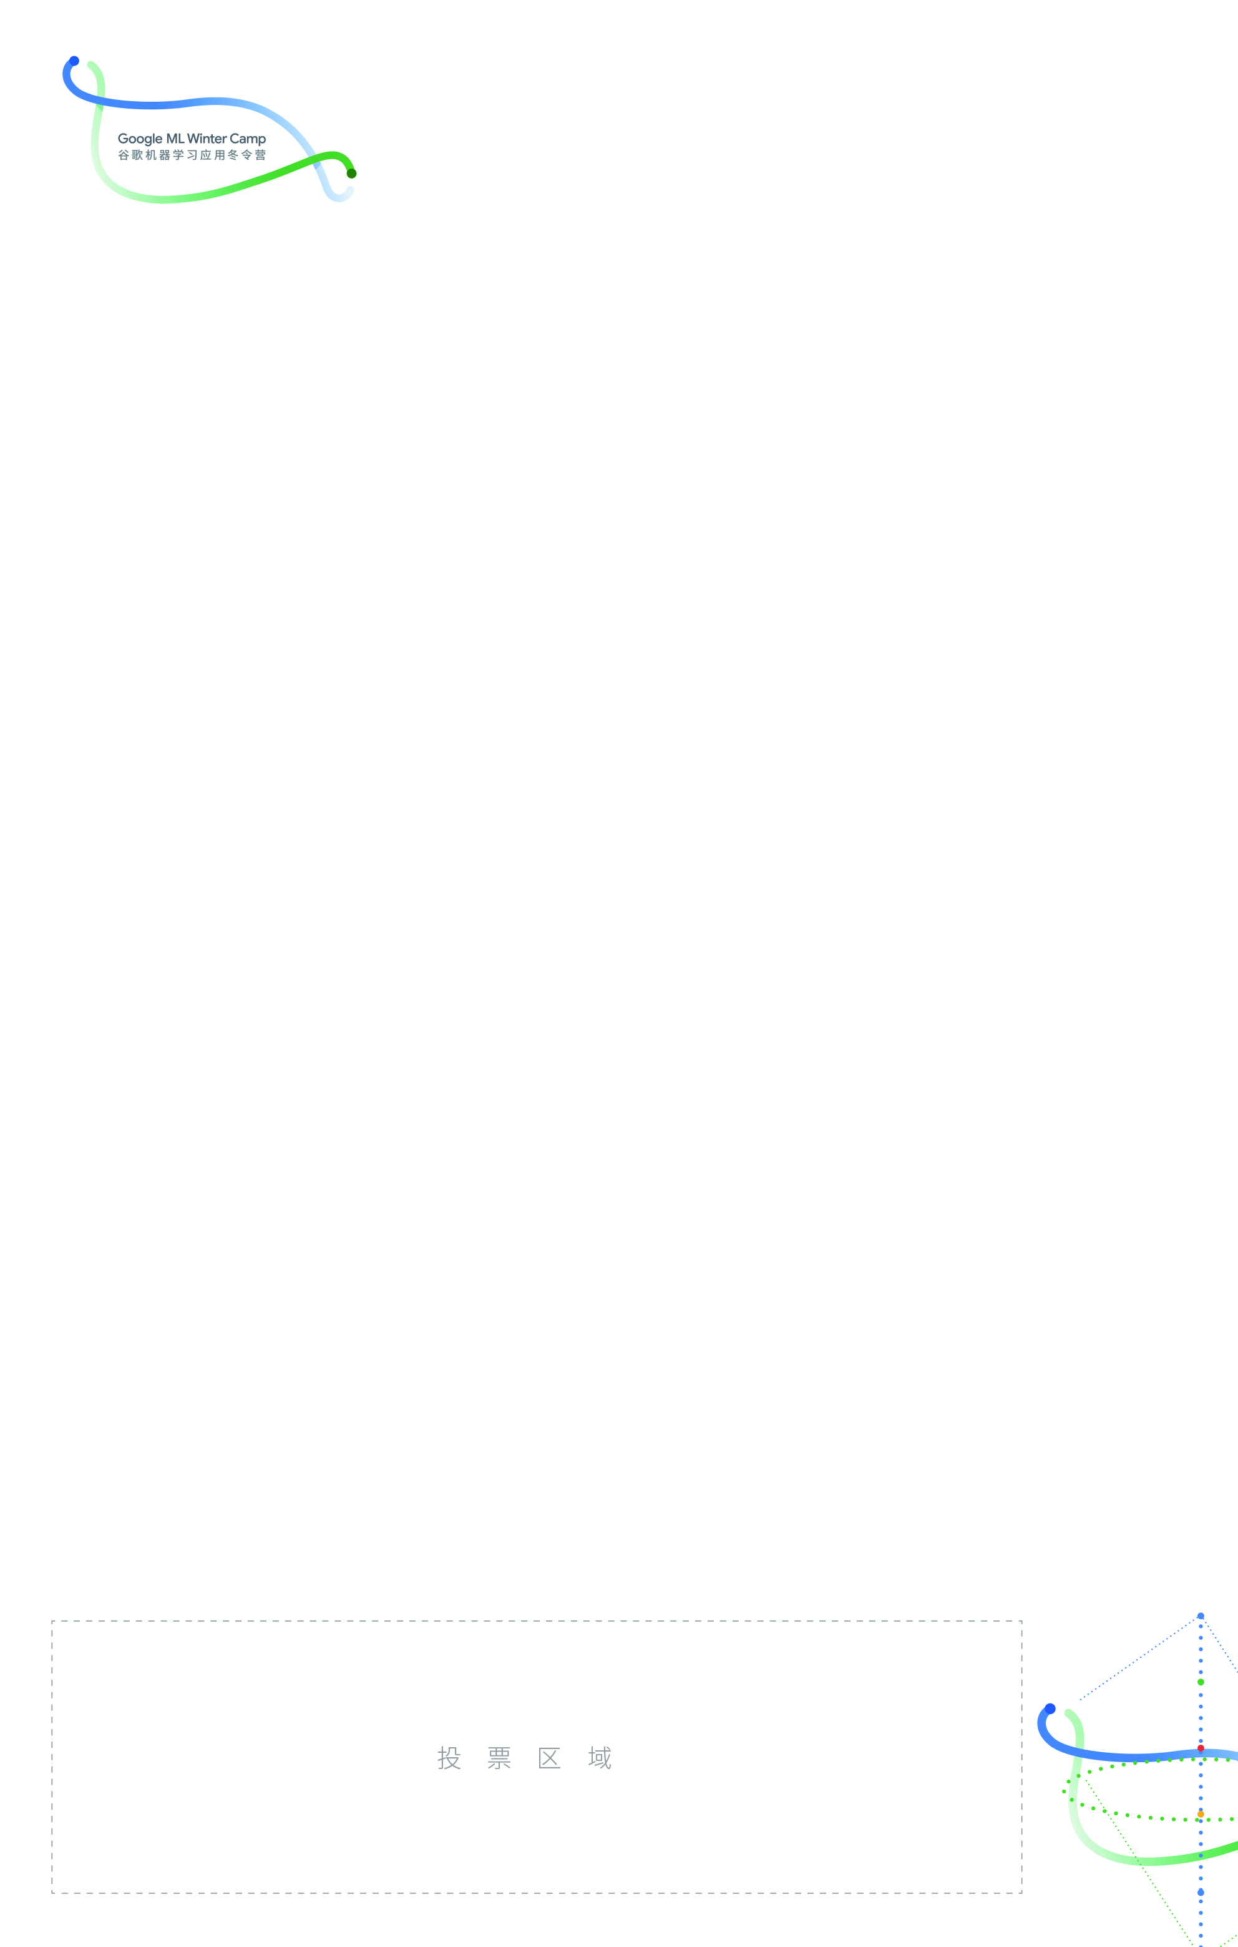
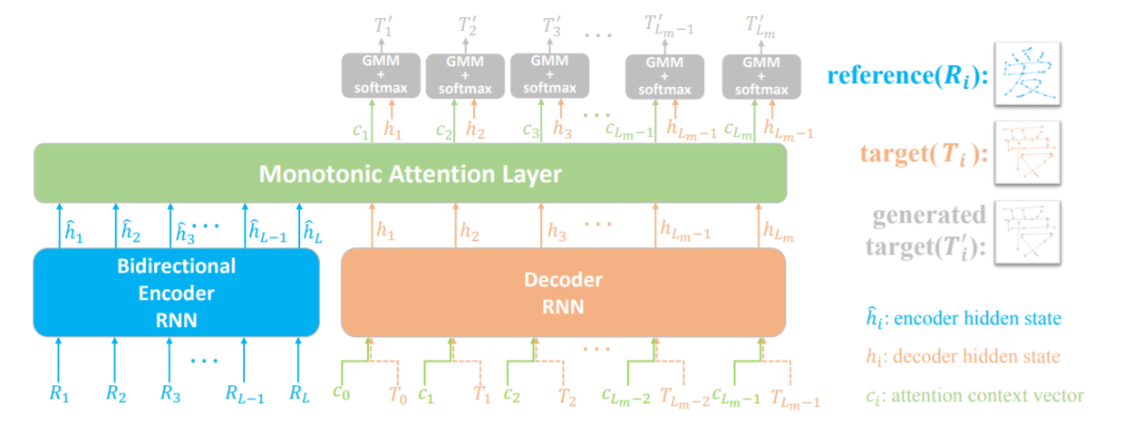
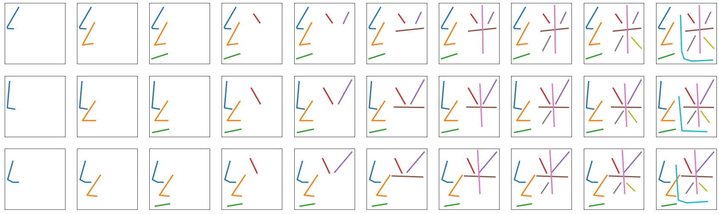
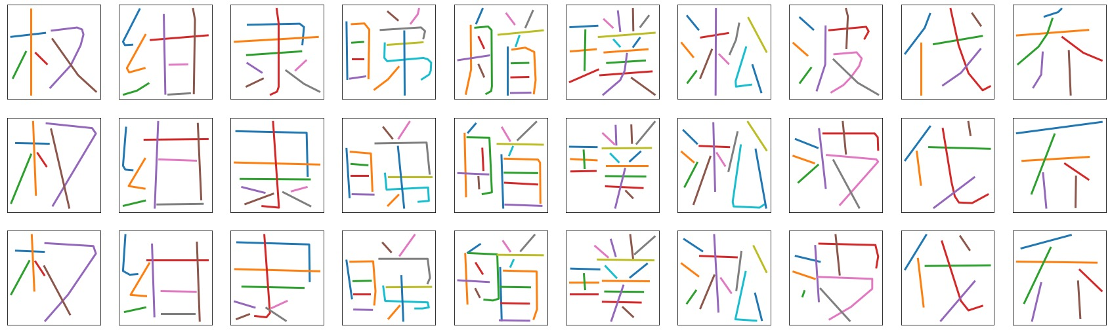
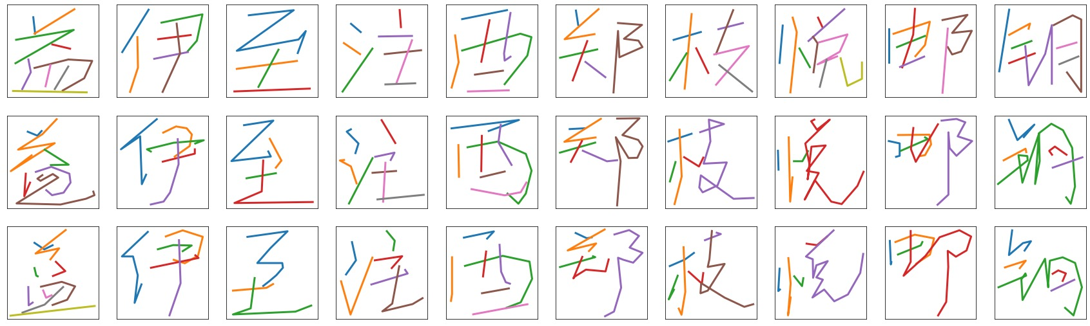
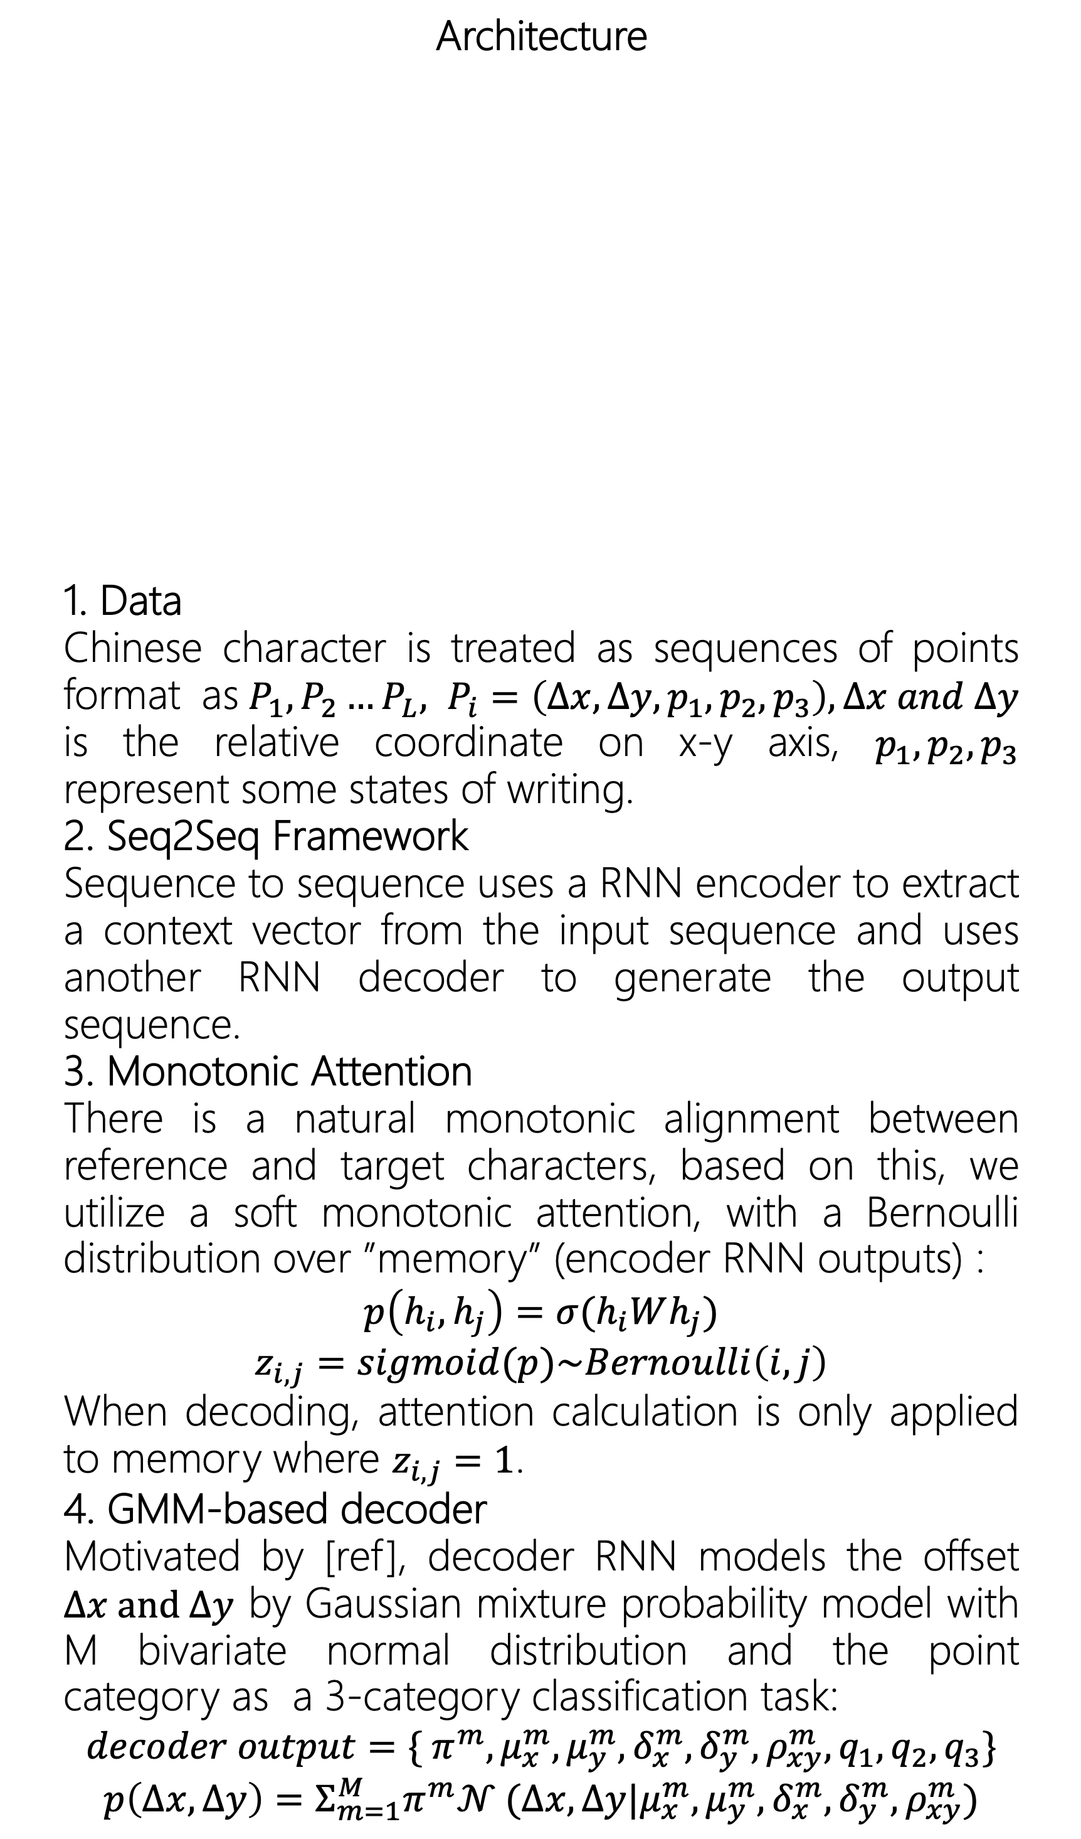

Can Machine Write? Chinese Fonts Generation via Recurrent Neural Network
To train our model, we specifically design a loss function:
$$Loss_{d}=−\frac{1}{L}Σ_{i=1}^{L}log⁡(Σ_{m=1}^{M}p^{m}(Δx_{i}, Δy_{i}))$$
$$Loss_{c}=−\frac{1}{L_{m}}Σ_{i=1}^{L}Σ_{k=1}^{3}p_{k,i}log⁡(q_{k,i})$$
Abstract
Despite the development of deep learning networks, Chinese font generation is still a rather challenging task. Most proposed models focus on the image-level features, utilize CNN to generate bitmaps. In this project, we focus on the temporal-level features, treat Chinese characters as sequences of points and propose a RNN-based network with monotonic attention mechanism based on this characteristic. Experimental results show that our model adapt to small-scale training data while maintaining a good result.
Architecture
1. Data
Chinese character is treated as sequences of points format as$P_{1}, P_{2}…P_{L}, P_{i}=\left(Δx, Δy, p_{1},p_{2},p_{3}\right), Δx and Δy$ is the relative coordinate on x-y axis, $p_{1},p_{2},p_{3}$ represent some states of writing.
2. Seq2Seq Framework
Sequence to sequence uses a RNN encoder to extract a context vector from the input sequence and uses another RNN decoder to generate the output sequence.
3. Monotonic Attention
There is a natural monotonic alignment between reference and target characters, based on this, we utilize a soft monotonic attention, with a Bernoulli distribution over ”memory” (encoder RNN outputs) :
$$p\left(h_{i}, h_{j}\right)=σ(h_{i}Wh_{j})$$
$$z_{i,j}=sigmoid(p)\sim Bernoulli\left(i, j\right)$$
When decoding, attention calculation is only applied to memory where $z_{i,j}=1$.
4. GMM-based decoder
Motivated by [ref], decoder RNN models the offset $Δx and Δy$ by Gaussian mixture probability model with M bivariate normal distribution and the point category as a 3-category classification task:
$$decoder output=\{{{ π}^{m},μ}_{x}^{m},μ_{y}^{m},δ_{x}^{m}, δ_{y}^{m},ρ_{xy}^{m},q_{1},q_{2},q_{3}\}$$
$$p\left(Δx, Δy\right)=Σ_{m=1}^{M}π^{m}𝒩 (Δx,Δy|μ_{x}^{m},μ_{y}^{m},δ_{x}^{m}, δ_{y}^{m},ρ_{xy}^{m})$$
Input
character
Ground
truth
Generated
result
Figure 1: Experiment Result of the FZ dataset, we can see the alignment between strokes of the two character.
Experiments
We experiment on two dataset, FangZheng font dataset and a handwritten dataset. In the training process, the former one uses 775 samples and the latter one uses 2000 samples.
Experiment results are as follows:
Comparing the result, we can find that FZ dataset is more consistent and regular than the handwritten dataset, so it needs less training samples to learn the character glyph.
Input
character
Ground
truth
Generated
result
Figure 2: Experiment Result of the FZ dataset, we can see our generated result is clear and correct.
Input
character
Ground
truth
Generated
result
Figure 3: Experiment Result of the handwritten dataset.
Conclusion
We focus on the sequential characteristic of Chinese character and propose a novel RNN-based model with monotonic attention mechanism, we conduct experiment on two dataset, results show that our model can generalize well on small-scale dataset while cost no performance drop.
Reference:
GRAVES A.: Generating sequences with recurrent neural net- works. arXiv preprint arXiv:1308.0850, 2013.
FontRNN: Generating Large-scale Chinese Fonts via Recurrent Neural Network. Computer Graphics Forum, 2019.

